Slide 1
Matrix Power Applications
Mostafa Saad Ibrahim
Teaching Assistant @ Cairo University

Slide 2
Fibonacci Sequence
Popular Sequence: 0 1 1 2 3 5 8 13 21 ….
Each number is sum of previous 2 numbers
E.g. 13 = 8 + 5
Base case: F0 = 0, F1 = 1
Recursive Rule: F(n) = F(n-1) + F(n-2)
Code
Recursive .. Exponential time
Iterative .. Linear time

Slide 3
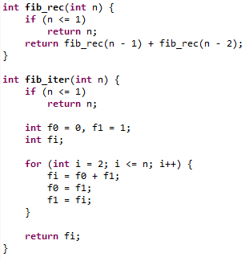
Fibonacci Sequence code

Slide 4
Matrix Approach: Observe
0 | 1
0 | 0
0 | 1
1 | 1
1 | 1
0 | 0
x
=
1 | 1
0 | 0
0 | 1
1 | 1
1 | 2
0 | 0
x
=
1 | 2
0 | 0
0 | 1
1 | 1
2 | 3
0 | 0
x
=
2 | 3
0 | 0
0 | 1
1 | 1
3 | 5
0 | 0
x
=

Slide 5
Matrix Approach: Generally
a | b
c | d
0 | 1
1 | 1
b | a+b
d | c+d
x
=
Initial matrix
Transition matrix
Updated matrix
Then given matrix with first row (a, b) we could move to (b, a+b)
Which means we moved one step in sequence
Then one more multiplication move another step
Then multiplying n times move us n steps
We could do all multiplication once in O(logn) only
Then multiply result in initial matrix to get answer after n steps

Slide 6
Matrix Approach: Then
0 | 1
0 | 0
0 | 1
1 | 1
^ 1
1 | 1
0 | 0
x
=
0 | 1
0 | 0
0 | 1
1 | 1
^ 2
1 | 2
0 | 0
x
=
0 | 1
0 | 0
0 | 1
1 | 1
^ 3
2 | 3
0 | 0
x
=
0 | 1
0 | 0
0 | 1
1 | 1
^ 4
3 | 5
0 | 0
x
=

Slide 7
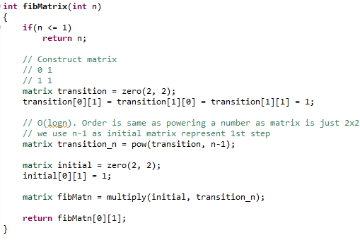
Fibonacci Matrix Code

Slide 8
Fibonacci Matrix: Observation
We care only with first row in initial matrix. First row in initial matrix is same as first row in transition. Then we could use transition matrix as initial too
So instead: initial x transition ^ n-1
Use transition ^ n
This just means little coding

Slide 9
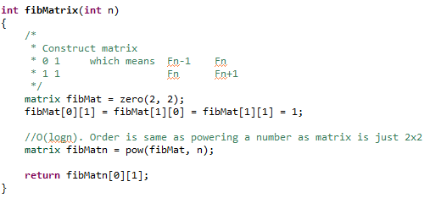
Fibonacci Matrix Code

Slide 10
The general approach
When ever we have initial state S0
And we move to next State using basic sum/multiply operation
Try to define initial state in square matrix : S0
Try to define the basic operations in transition matrix: T
Such That: S0 x T = S1
Then to move to nth state: S0 x T^ n-(d-1)

Slide 11
Approach benefit?
If we need Fibonacci number with n = 10^18, liner approach won’t be good choice
However, matrix power will take only log(n) which is faster
Rule: If n is too big and the 2 matrices have low dimensions, then we could move to nth state in O(logn)

Slide 12
Constructing matrices
This is the tough part. We learn it by experience.
Typically matrices are square
If terms are only summed and multiplied by constants deriving is easy. For others, you need to think more.
If F(i) depends on last k terms, try first matrix k x k
Focus with First row, each element expresses an F(i)
Initialize it with the base cases
Construct transition to move them

Slide 13
Fibonacci initial matrix
In Fibonacci, F(n) depends on 2 terms only: F(n-1) + F(n-2). So we have 2 base cases.
Then define 2x2 matrix. Fill first row and others zeros
Let F[0][0] = F[0]. F[0][1] = F[1]
0 1
0 0

Slide 14
Fibonacci transition matrix
In transition matrix, construct each column such that, first row x ith column calculate for us new F(i) in F[0][i]
Let first row values are (a, b). We need to move to (b, a+b)
(a, b) x (0, 1) = b. Then first column (0, 1)
(a, b) x (1, 1) = a+b. Then first column (1, 1)
Note, typically we shift n-1 value and calculate only one

Slide 15
Imaginary sequence: initial
F[0] = 1, F[1] = 3, F[2] = 4
F[n] = 2 * F[n-3] + F[n-2] - 4 * F[n-1]
We depend on 3 terms, construct 3x3 and fill with base cases
1 3 4
0 0 0
0 0 0

Slide 16
Imaginary sequence: transition
Now we need to prepare column values.
We know that initial matrix first row:
1 3 4 (base case)
and first row in updated matrix after 1 step
3 4 X
That is first 2 columns just shift 2 values. 3rd column only do calculation 2 * F[n-3] + F[n-2] - 4 * F[n-1]
0 0 2
1 0 1
0 1 -4

Slide 17
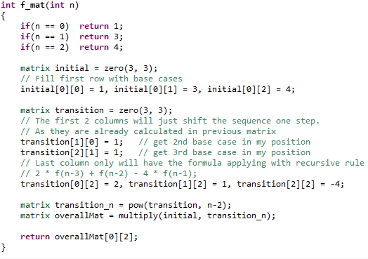
Imaginary sequence: Code

Slide 18
Let’s play a game: SPOJ(SUMSUMS)
N players has N numbers. After each round, each one new value is sum of other N-1 Values
Initial 0: 1 0 4
Round1: 4 5 1
Round2: 6 5 9
Round3: 14 15 11
Round4: 26 25 29
Calculate what each one has after N rounds

Slide 19
Let’s play a game
Each. Construct initial matrix NxN with first row the N values
Construct transition matrix with each column all ones except ith cell
1 0 4 0 1 1
0 0 0 x 1 0 1
0 0 0 1 1 0
What if N = 10^5? Big matrices!
Hint: Each player answer could be computed indepednetly

Slide 20
Permutation Multiplication
Say we have a permutation: 0 1 2 3
Applying a permutation on other, aka multiplication, means to map its values according to the permutation.
So Applying 2 0 1 3 MEANS:
0 -map-> 2
1 -map-> 0
2 -map-> 1
3 -map-> 3
Problem has other solutions in Permutation video

Slide 21
Permutation Multiplication
(0 1 2 3) * (2 0 1 3) = 2 0 1 3
(2 3 1 0) * (2 0 1 3) = 1 3 0 2
(3 2 0 1) * (2 0 1 3) = 3 1 2 0
Given initial string Sand permutation P, apply P on S N times
Initial matrix, first row = S
Transition column just shift character to right location

Slide 22
And so on
It is all about initial state and transition
When you find N is too big (e.g. 10^9), and you think we could model as initial / transition, do it
E.g. we have machine that work on 2d grid. It do some rearrangement and updates for the grid each second. Answer after 10^10 second?

Slide 23
Multiple Transitions Matrices
Sometimes, operations are complicated to be handled in one transition matrix. Divide operations to sequence of steps.
For each block of operations, define transition matrix
So say we have finally 3 transitions T1, T2, T3
Then let T = T1 * T2 * T3
Now S1 = S0 8 T

Slide 24
Powers of Adjacency Matrix
If we have binary adjacency matrix of a graph, what does powering it means?
If matrix is powered to k then:
Each cell (i, j) = the number of paths of length exactly k from node i to node j. Cell(i, i) is for cycles.
Order is O(n^3 logn)

Slide 25
Adjacency Matrix: At most path
If we want number of paths of length at most k for specific (i, j), We may do little changes in the matrix to calculate this too. Typically we make it (n+1)x(n+1) matrix to include this info
If we want to calculate that to all values, then we need to calculate Sum Powers: A^0 + A^1…A^k

Slide 26
Adjacency Matrix: At most path
To avoid the much calculation of sum powers, here is a faster way using block matrix
Let A be the adjacency matrix (nxn)
Define B to be (2n x 2n) .. Fill it with following
A 0
A I => I is identity matrix
When Power it to k:
[A^{k} 0 ]
[A¹+A² ... A^{k} I ] Order is O(n^3 logn)

